Slide 1
Loan Prediction
By Adriana Caetano and Torsha Mazumdar

Slide 2

Motivation
Dream Housing Finance company deals in all home loans
Automate loan eligibility
Online application form

Slide 3
Problem Category
Supervised Learning - learning from the data based on sample input-output pairs.
Input - Customer Attributes, Loan Amount, Term
Output/Label - Loan Status
Binary Classification - Loan Status is either Y(Yes) or N(No).

Slide 4
Dataset
The Loan Eligible dataset can be downloaded from Kaggle
It’s a short dataset with 13 columns and 614 rows
This dataset has some missing values and some of the features have a wide range of values, so we’ll need to preprocess it.

Slide 5
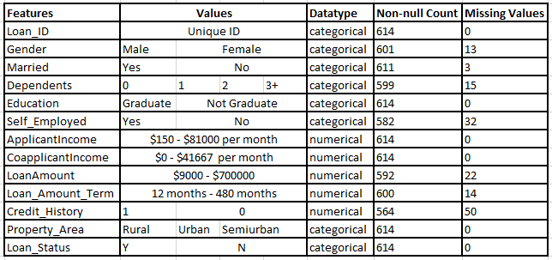
Dataset Features

Slide 6
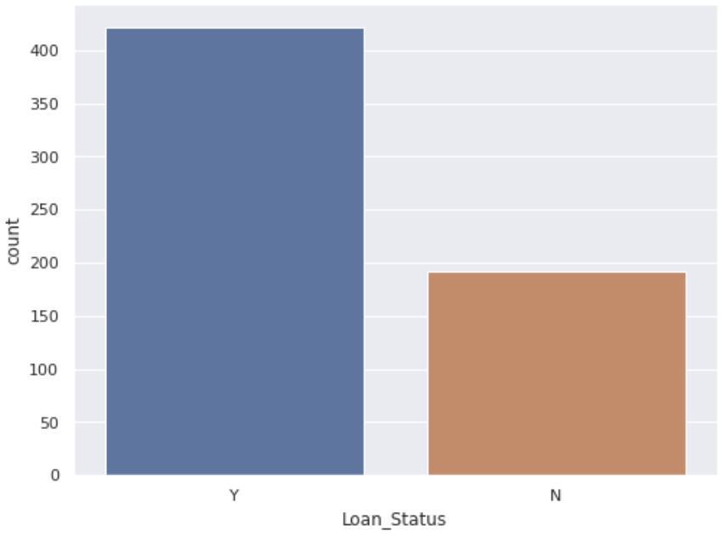
Dataset Visualization
Loan Status
Yes: 422 (69%)
No: 192 (31%)

Slide 7
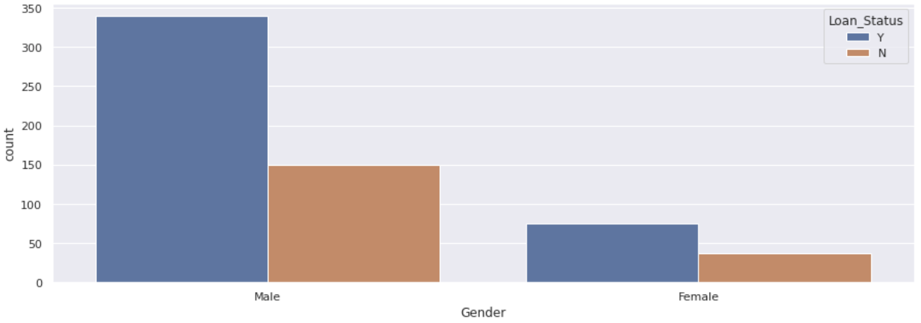
Dataset Visualization
Gender
Male: 489 (Y 69%, N 31%) Female: 112 (Y 67%, N 33%)

Slide 8
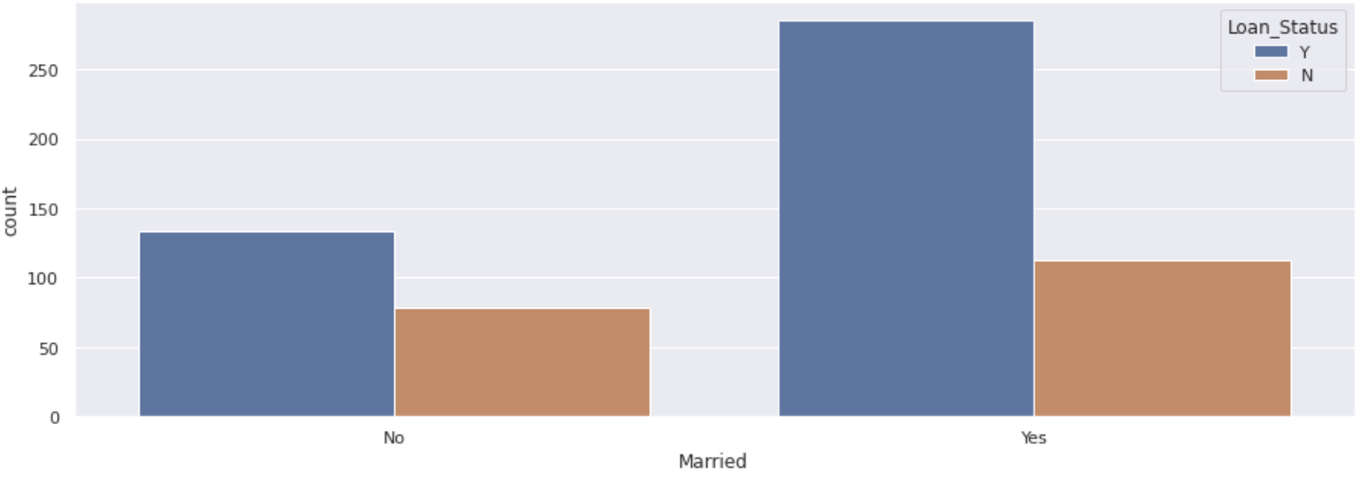
Dataset Visualization
Married
No: 213 (Y 63%, N 37%) Yes: 398 (Y 72%, N 28%)

Slide 9
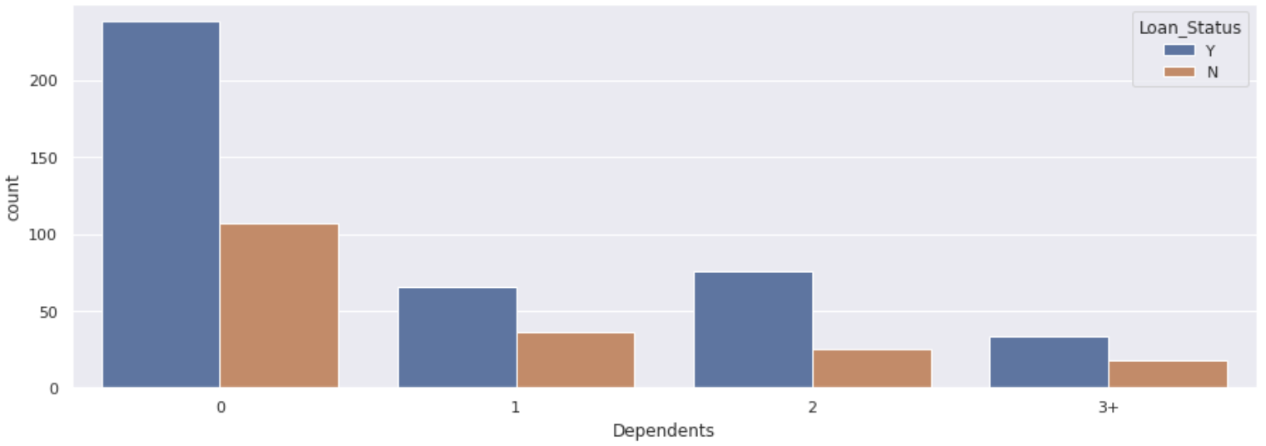
Dataset Visualization
Dependents
0: 345 (Y 69%, N 31%) 1: 102 (Y 65%, N 35%) 2: 101 (Y 76%, N 24%) 3+: 51 (Y 64%, N 36%)

Slide 10
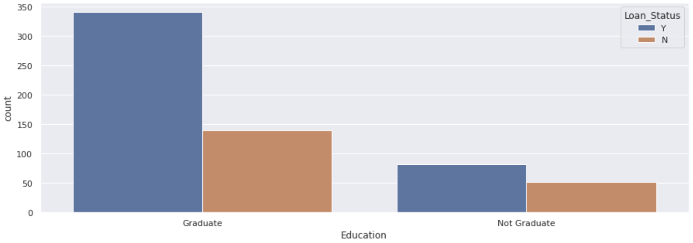
Dataset Visualization
Education
Graduate: 480 (Y 71%, N 29%) Not Graduate: 134 (Y 61%, N 39%)

Slide 11
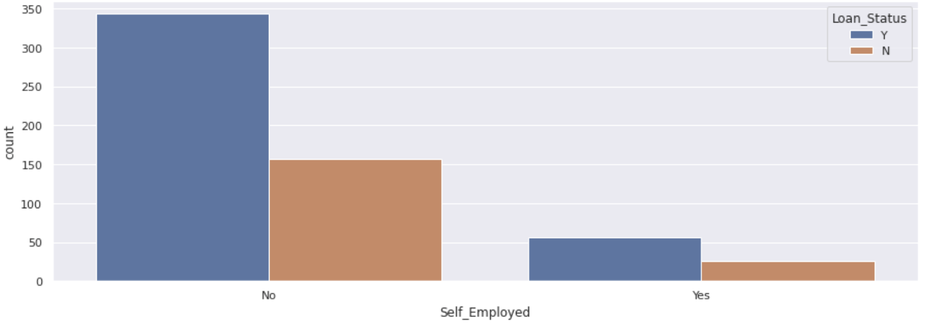
Dataset Visualization
Self-Employed
No: 500 (Y 69%, N 21%) Yes: 82 (Y 68%, N 22%)

Slide 12
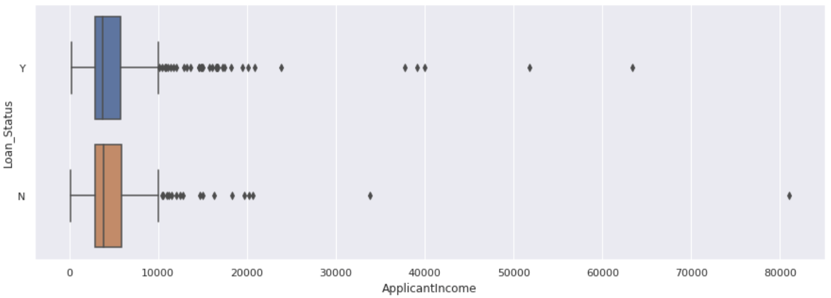
Dataset Visualization
Applicant Income
Min: 150 Max: 81000 25%: 2877 50%: 3812 75%: 5795 Mean: 5403

Slide 13
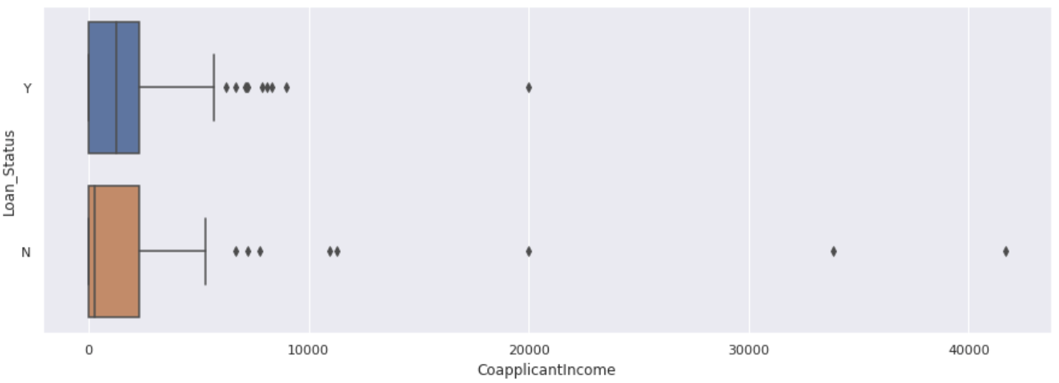
Dataset Visualization
Co-Applicant Income
Min: 0 Max: 41667 25%: 0 50%: 1188 75%: 2297 Mean: 1621

Slide 14
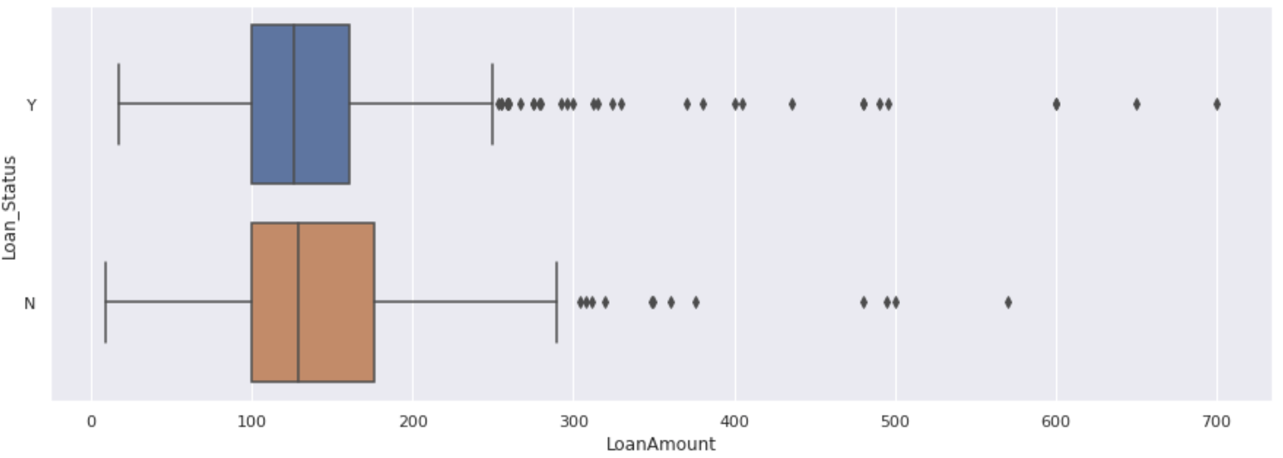
Dataset Visualization
Loan Amount
Min: 9k Max: 700k 25%: 100k 50%: 128k 75%: 168k Mean: 146k

Slide 15
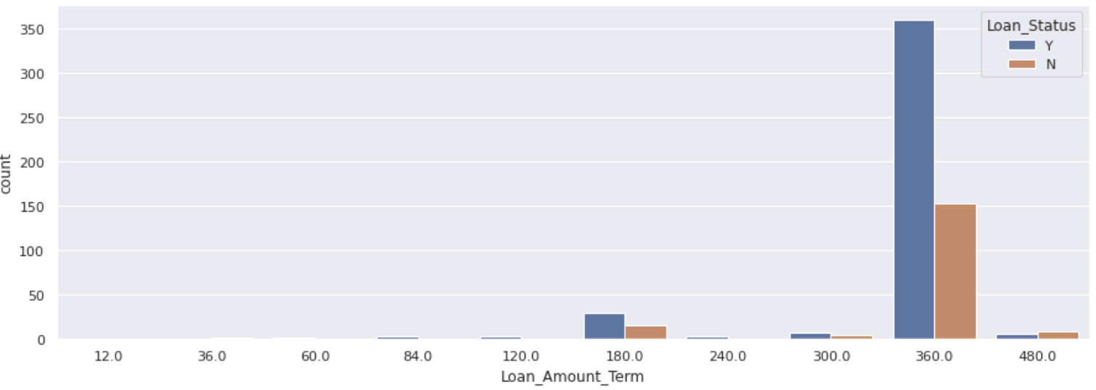
Dataset Visualization
Loan Amount Term
0-7 years: 9 (Y 66%, N 34%) 10 years: 3 (Y 100%) 15 years: 44 (Y 66%, N 34%) 20 years: 4 (Y 75%, N 25%) 25 years: 13 (Y 62%, N 38%) 30 years: 512 (Y 70%, N 30%) 40 years: 15 (Y 40%, N 60%)

Slide 16
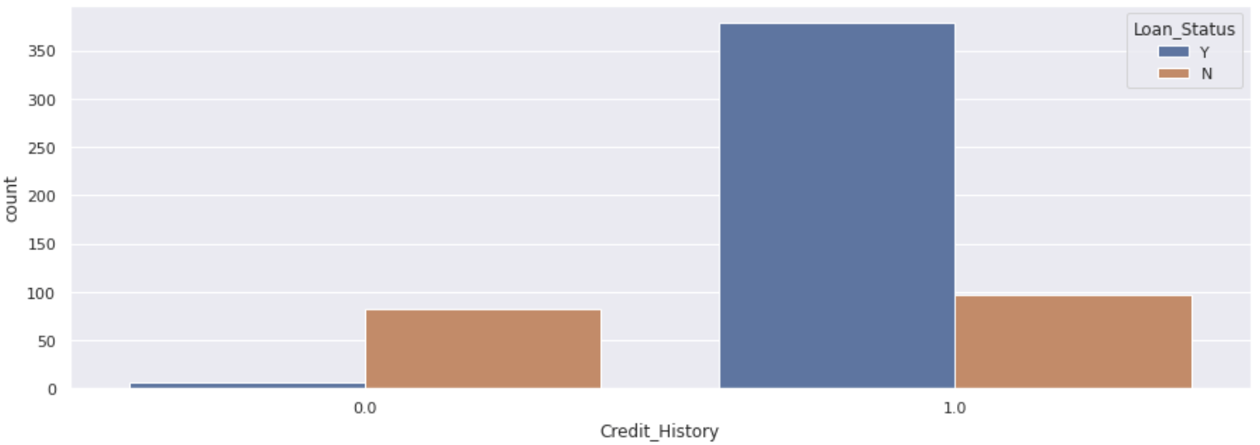
Dataset Visualization
Credit History
0: 89 (Y 8% , N 92%) 1: 475 (Y 80% , N 20%)

Slide 17
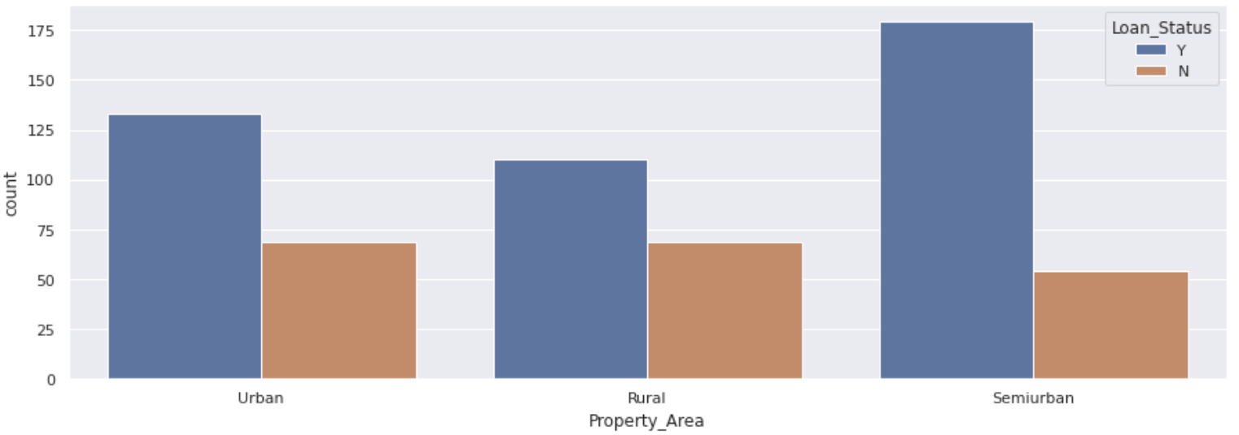
Dataset Visualization
Property Area
Urban: 202 (Y 66% , N 34%) Rural: 179 (Y 61% , N 39%) Semi-Urban: 233 (Y 77%, N 23%)

Slide 18
Preprocessing the Dataset
Fill up the missing values
Mode for categorical features
Mean or median for numerical features
Zero for dependents: dependents can be categorized as missing not at random (if a person "forgot" to fill up the number of dependents, most likely they don't have dependents)
Zero for credit history: credit history can be categorized as missing not at random (if a person "forgot" to fill up the credit history, most likely they don't have history)

Slide 19
Preprocessing the Dataset
Fill up the missing values
Gender 13 → mode
Married 3 → mode
Dependents 15 → 0
Self_Employed 32 → mode
LoanAmount 22 → mean
Loan_Amount_Term 14 → median
Credit_History 50 → 0

Slide 20
Preprocessing the Dataset
Upsampling the dataset
Imbalanced Initial Dataset -
422 labels for Y (69%)
192 labels for N (31%)
Upsampled Dataset -
422 labels for Y
422 labels for N
Total Count of Upsampled dataset = 844

Slide 21
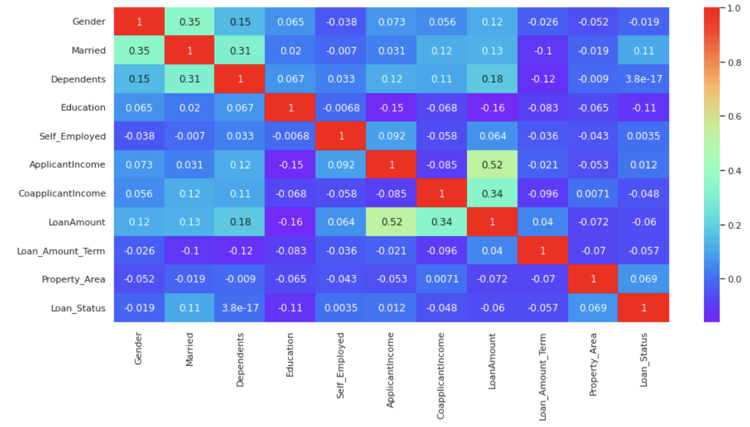
Preprocessing the Dataset
Categorical values into numerical with LabelEncoder

Slide 22
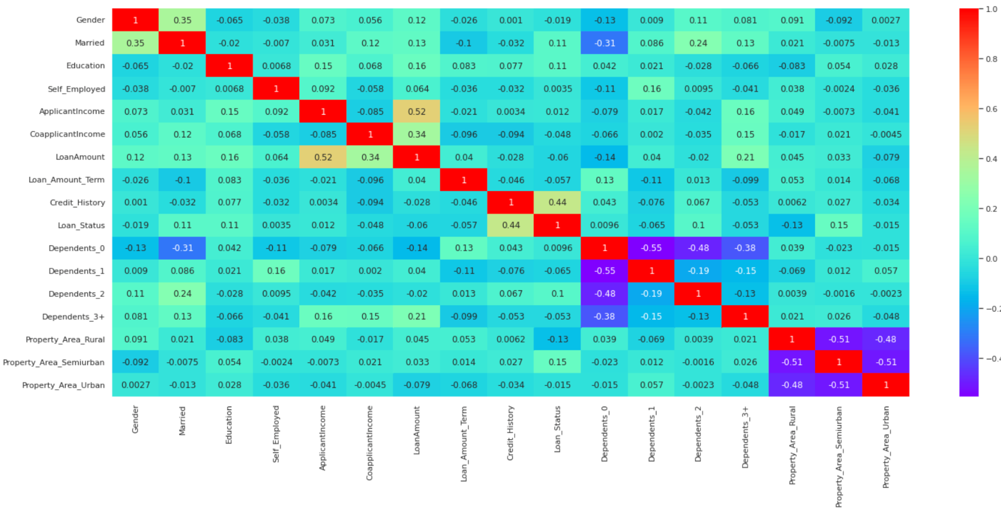
Preprocessing the Dataset
Categorical values into numerical with get_dummies

Slide 23
Preprocessing the Dataset

Slide 24
Splitting the Dataset
Training -
70% of dataset
590 rows
Test -
30% of dataset
254 rows
No Validation dataset, since data available is less.
Use of k- fold cross validation to tune hyperparameters

Slide 25
Methods
Decision Tree Classifier
simple and easy to interpret
trees can be visualized
Random Forest Classifier
have much higher accuracy than the single decision tree
doesn’t overfit the model, thus gives a good prediction on unseen datasets
low bias and low variance
Logistic Regression
efficient for linear dataset
it can handle both dense and sparse input

Slide 26
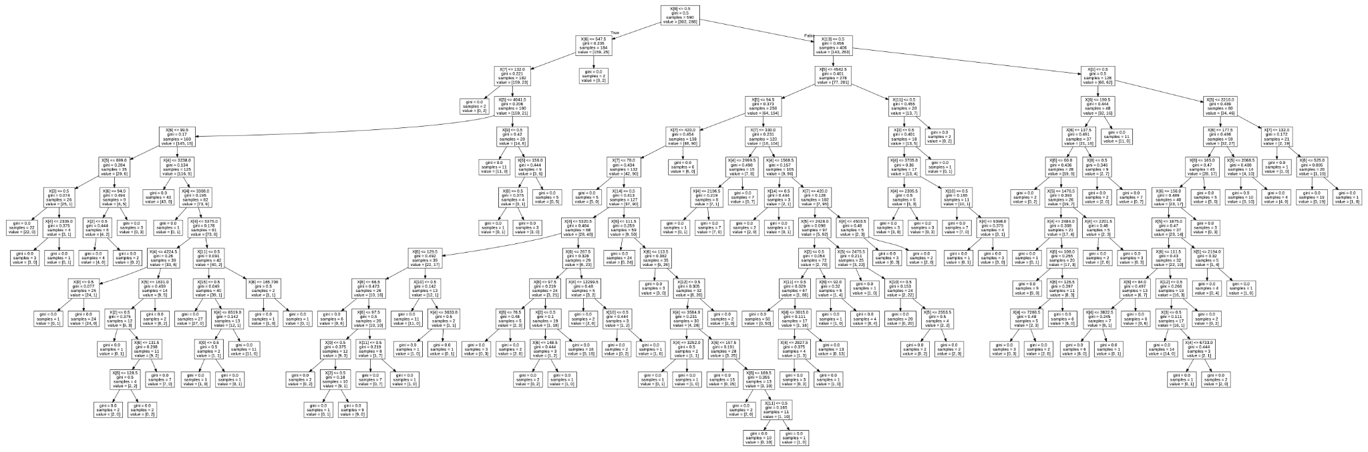
Decision Tree Classifier
Default
Depth = 14 Number of leaves = 106

Slide 27
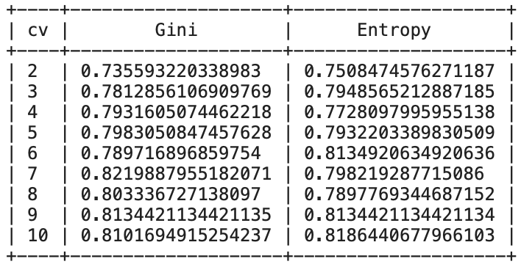
Decision Tree Classifier
Experiments: Gini vs Entropy, k-fold Cross Validation
Overfitting??
We select k=7 and Gini

Slide 28
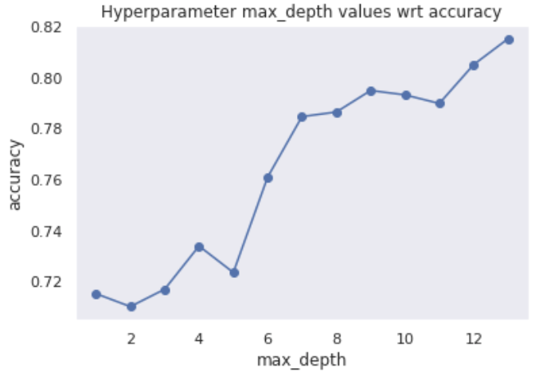
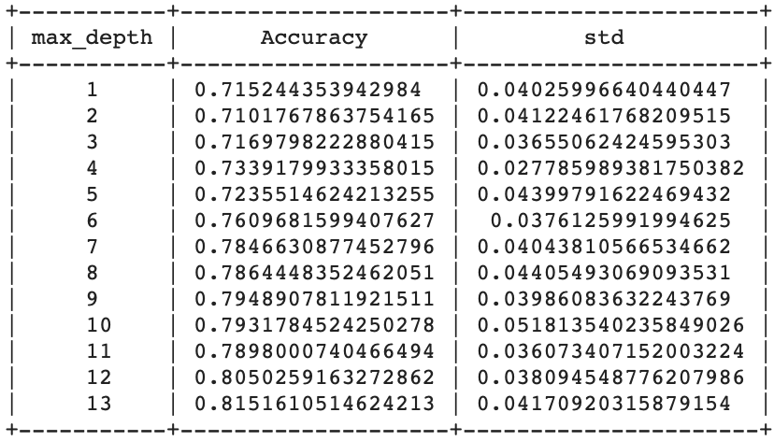
Decision Tree Classifier
Experiments: max_depth
We select max_depth=9

Slide 29
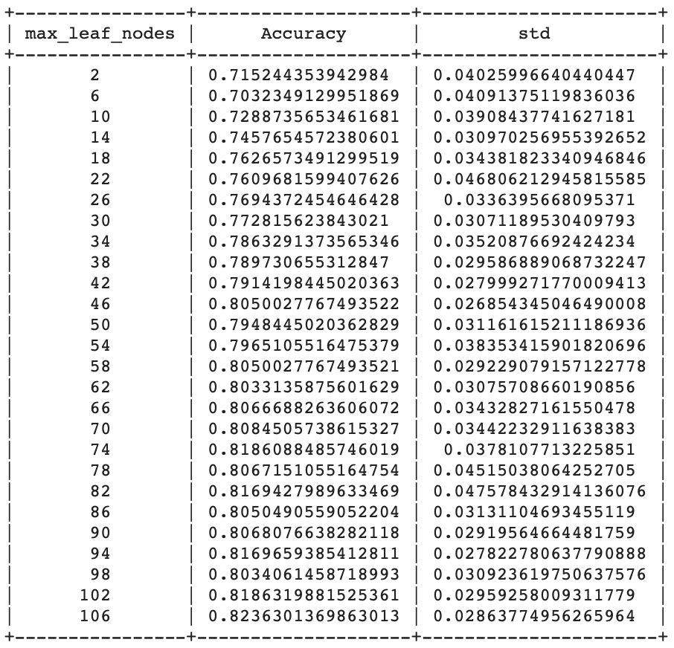
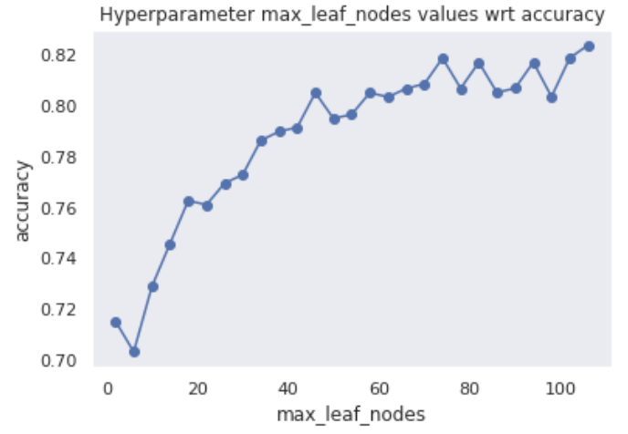
Decision Tree Classifier
Experiments: max_leaf_nodes
We select max_leaf_nodes=46

Slide 30
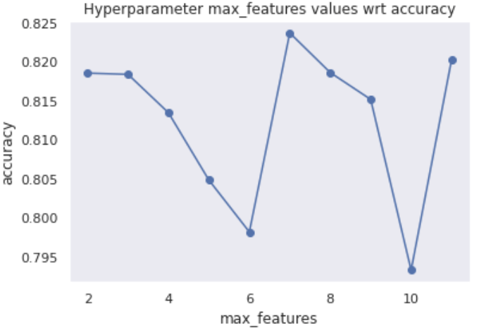
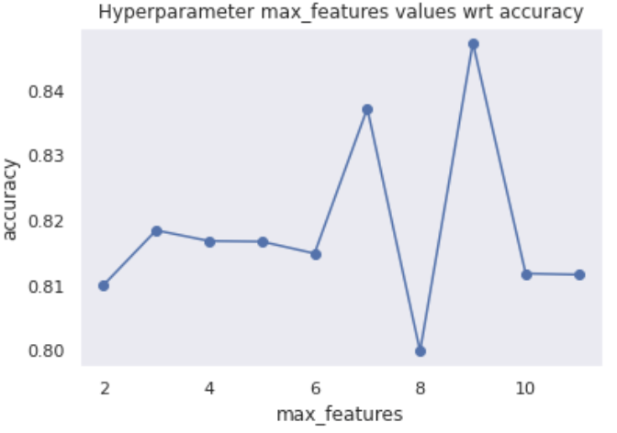
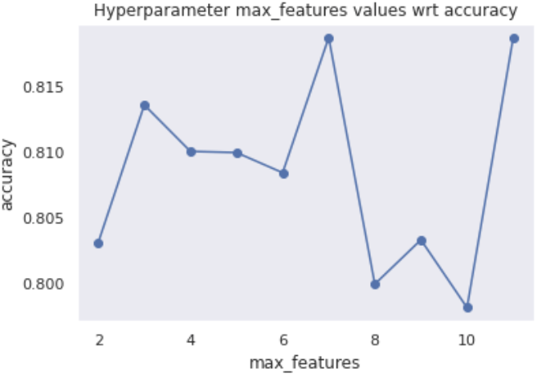
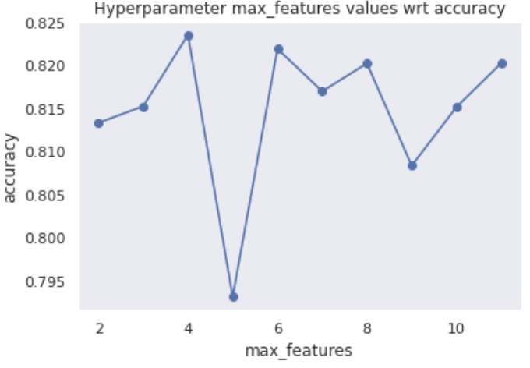
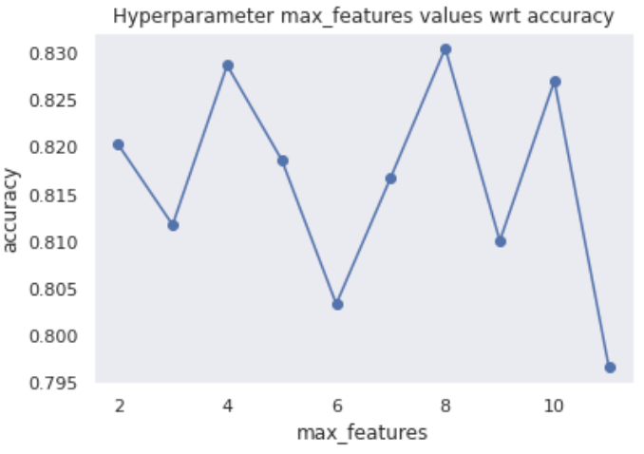
Decision Tree Classifier
Experiments:
max_features
Random choices

Slide 31
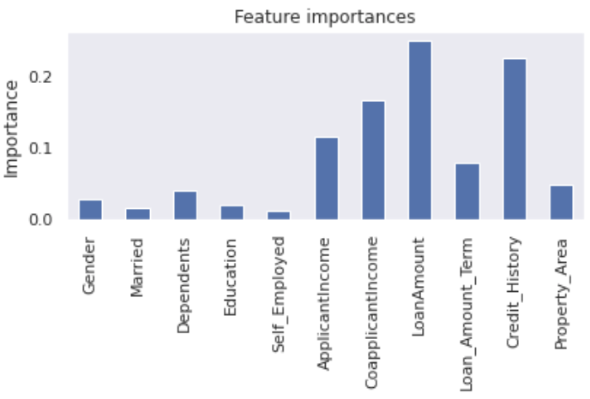
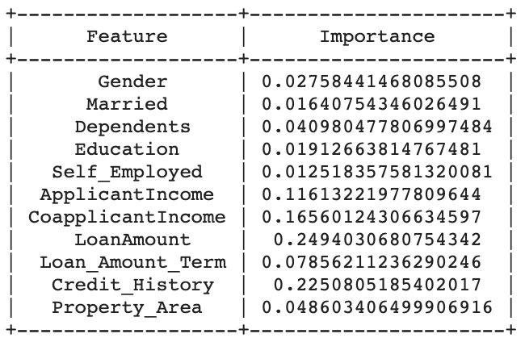
Decision Tree Classifier
Experiments: feature_importances_

Slide 32
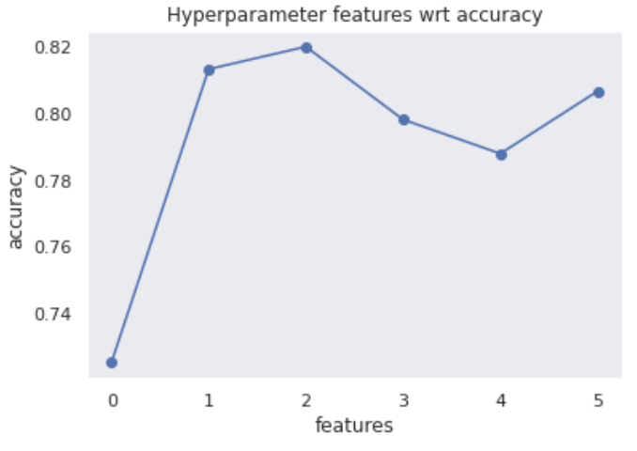
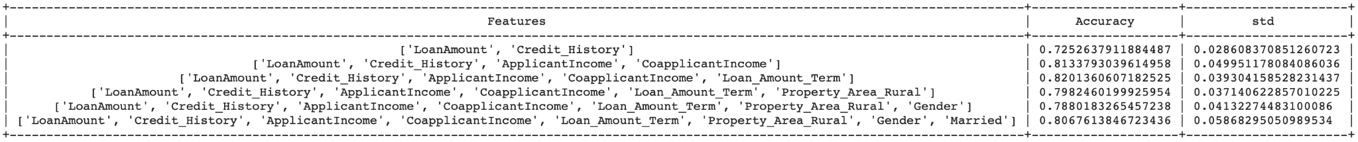
Decision Tree Classifier
Experiments: feature_importances_
LoanAmount
Credit_History
ApplicantIncome
CoapplicantIncome
Loan_Amount_Term

Slide 33
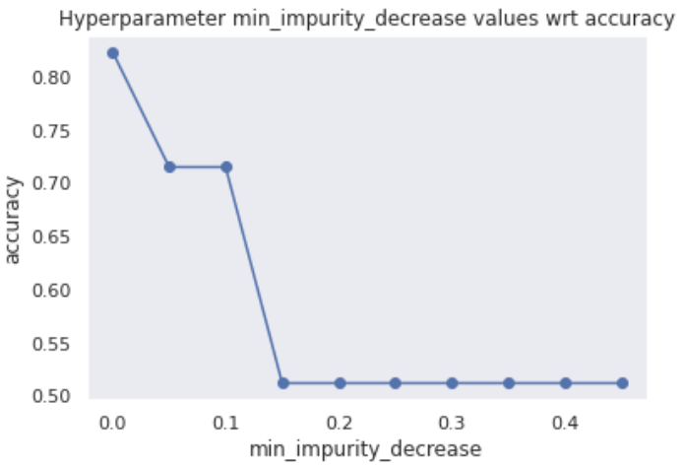
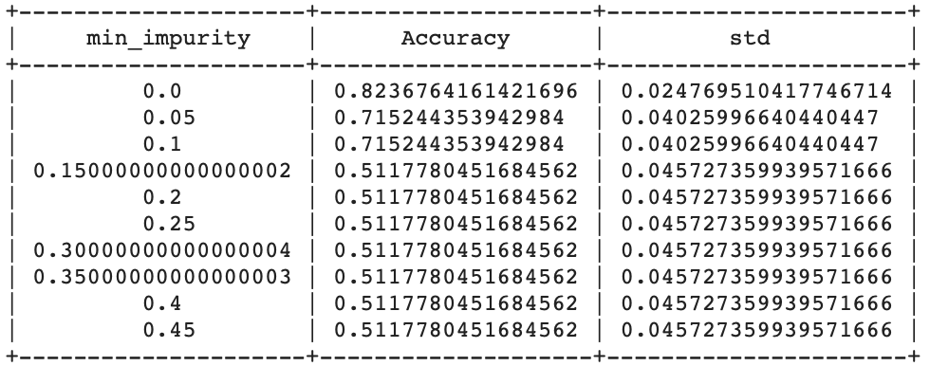
Decision Tree Classifier
Experiments: min_impurity
No improvement

Slide 34
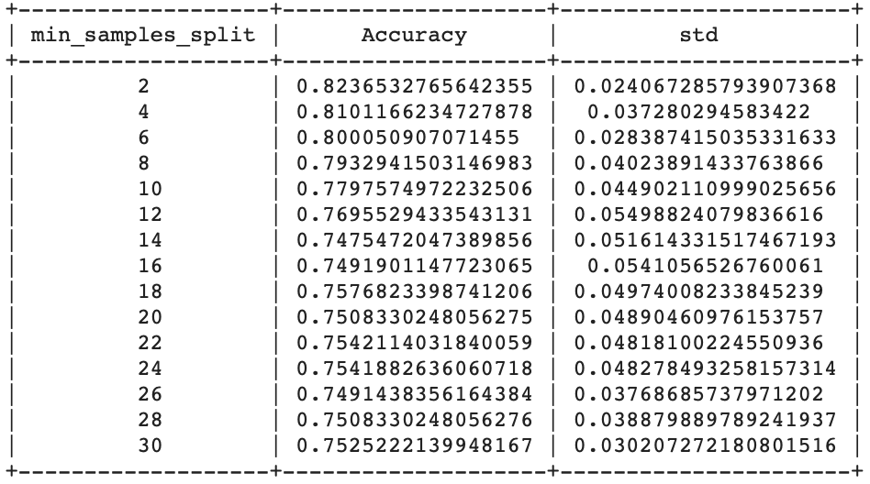
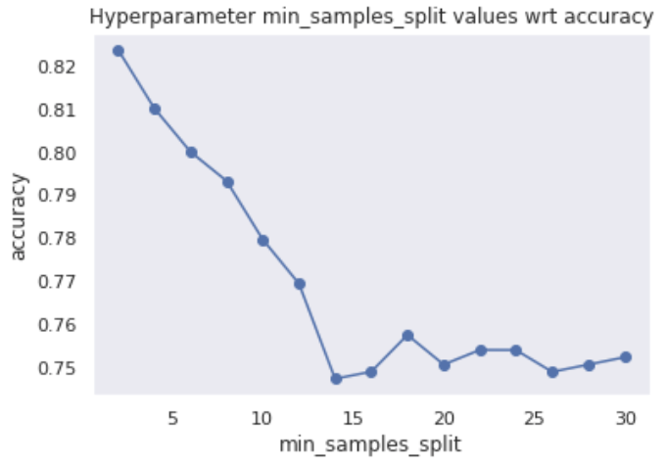
Decision Tree Classifier
Experiments: min_smaples_split
No improvement

Slide 35
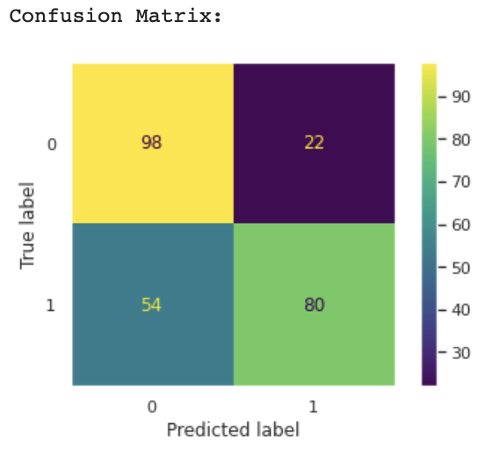
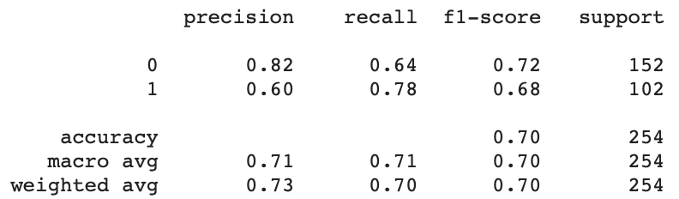
Decision Tree Classifier
Evaluation: criterion (Gini), cv (8-fold), max depth ( 9), max_leaf_nodes (46), features ['LoanAmount', 'Credit_History', 'ApplicantIncome', 'CoapplicantIncome', 'Loan_Amount_Term']

Slide 36
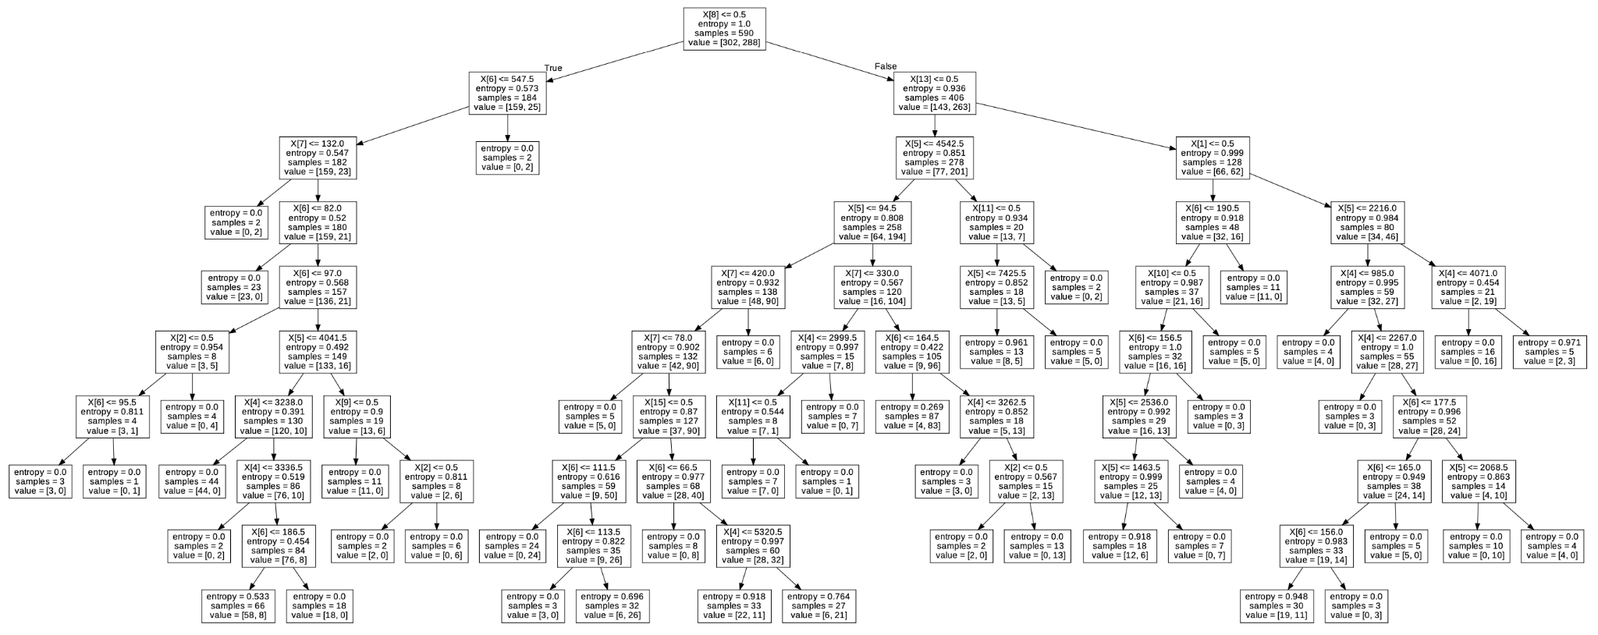
Decision Tree Classifier
Final Tree

Slide 37
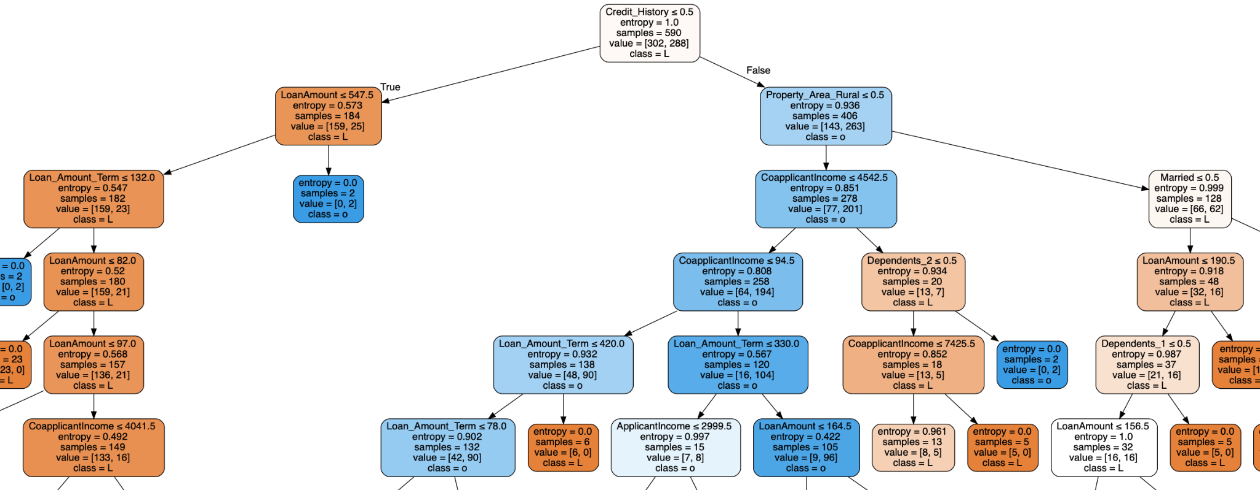
Decision Tree Classifier
Final Tree

Slide 38
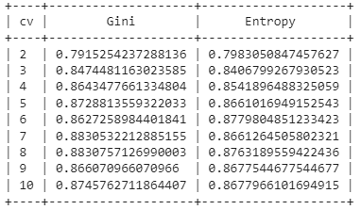
Random Forest Classifier
Experiment : Gini vs Entropy, k-fold Cross Validation
Overfitting??
We select k=8 and Gini

Slide 39
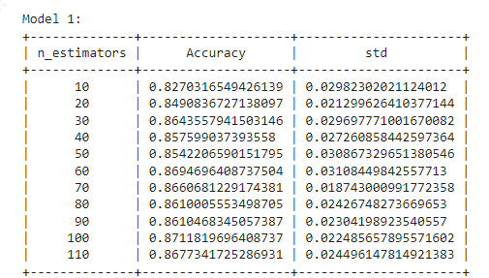
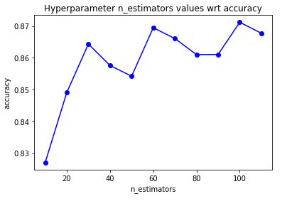
Random Forest Classifier
Experiment : tune n_estimators
We select n_estimators=100

Slide 40
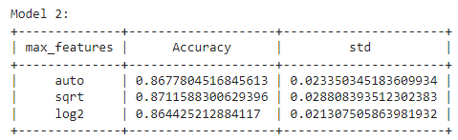
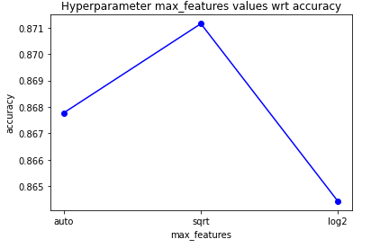
Random Forest Classifier
Experiment : tune max_features
We select max_features=sqrt

Slide 41
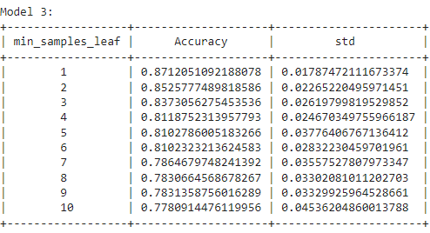
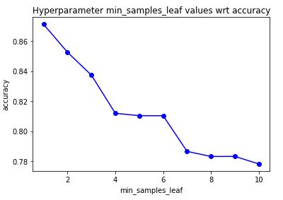
Random Forest Classifier
Experiment : tune min_samples_leaf
We select min_samples_leaf=1

Slide 42
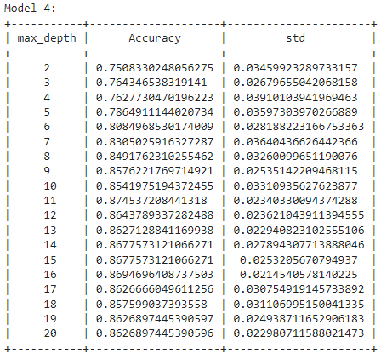
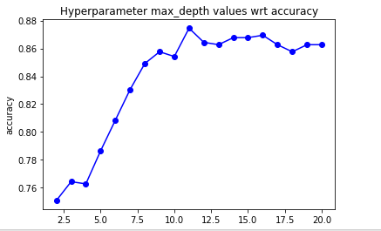
Random Forest Classifier
Experiment : tune max_depth
We select max_depth=14

Slide 43
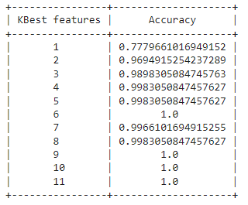
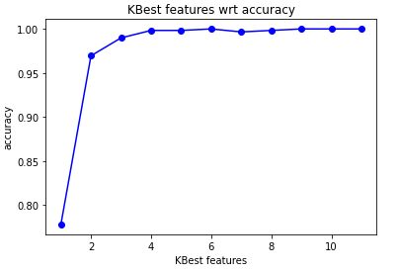
Random Forest Classifier
Experiment : select k Best Features
We select k=8

Slide 44
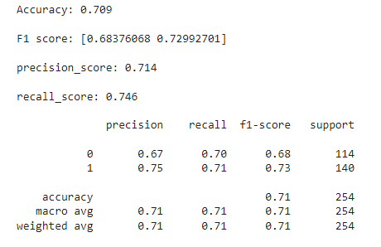
Random Forest Classifier
Test: select k Best Features

Slide 45


Random Forest Classifier
Evaluation : criterion(Gini), n_estimators(100), min_samples_leaf(1), max_depth(14), max_features(sqrt)

Slide 46


Logistic Regression
Experiment - different solvers
Since our data set is small, ‘newton-cg’ and 'lbfgs' are appropriate to use. We decided to choose 'lbfgs', the default solver, because it only stores the last few updates and saves memory.

Slide 47


Logistic Regression
Experiment - max_iterations parameter
No difference was found.

Slide 48


Logistic Regression
Experiment : k-best features
No improvement was found

Slide 49


Logistic Regression
Evaluation
Since no improvement was found, we keep the default model.

Slide 50
Best Model
Model | Accuracy | Recall
Decision Tree | 0.7 | 0.7
Random Forest | 0.82 | 0.82
Logistic Regression | 0.67 | 0.82

